Slide 1
Twitter Sentiment Analysis
USING MACHINE LEARNING
Under the Supervision of
Prof. Biswajit Saha

Slide 2
GROUP MEMBERS
Akanksha Priya
UNIVERSITY ROLL NO. 12000118128
Sashwat Jha
UNIVERSITY ROLL NO. 12000118045

Slide 3
INTRODUCTION
Sentiment analysis is a part of text mining. Sentiment Analysis on Twitter refers to the application of sophisticated text mining techniques, also termed as option mining.
It is used to examine dialogues, opinions, and exchange of views in order to make corporate decisions, conduct political analysis, and evaluate public behavior.
It may be classified as an Opinion mining approach for evaluating the underlying emotion of text communications like tweets.

Slide 4


SENTIMENT ANALYSIS
Sentiment analysis, also referred to as opinion mining, is an approach to natural language processing (NLP) that identifies the emotional tone behind a body of text.
This is a popular way for organizations to determine and categorize opinions about a product and service. It involves the use of data mining, machine learning and artificial intelligence to mine text for sentiment and subjective information.

Slide 5

TWITTER SENTIMENT ANALYSIS
Twitter sentiment analysis allows us to keep track of what’s being said about our products or services on social media, and can help us detect angry customers or negative mentions before they escalate. Various techniques have emerged in this field of study, proposing strategies to train a model and then test it to ensure its efficiency.
The aim while performing sentiment analysis on tweets is basically to classify the tweets into different sentiment classes accurately.

Slide 6
PROBLEM
STATEMENT
The problem in sentiment analysis is classifying the polarity of a given text at the document, sentence, or feature/aspect level.
Classifying the expressed opinion in a document, a sentence, a tweet or an entity feature/aspect into six different emotion classes.

Slide 7
OBJECTIVES
To implement an algorithm for automatic classification of text/tweets into different sentiment classes.
Graphical representation of the sentiment in the form of Pie-Chart.
To analyze people's sentiments, attitudes, opinions, emotions, etc. towards products and services.

Slide 8
WHY TWITTER SENTIMENT ANALYSIS IS OF URGENT SOCIAL NEED
Business
Companies can use it to develop their business strategies, to assess customers’ feelings towards products or brands.
Public Actions
Here, it can be used for monitoring and analyzing social phenomena, for predicting potentially dangerous situations and determining the general mood of the blogosphere.
Politics
In politics, it can be used to keep track of political views, to detect consistency and inconsistency between statements and actions at the government level.

Slide 9
FEATURES
01
02
03
04
GLOBAL SENTIMENT
SENTIMENT AT ATTRIBUTE LEVEL
SENTIMENTS DETECTED
AGREEMENT
& DISAGREEMENT
General opinion expressed in tweets, blog posts, reviews.
Analyzes the specific sentiment of each tweet.
Includes joy, Sadness, anger, surprise, fear or Love
Identifies opposing opinions- contradictory, ambiguous

Slide 10
CHALLENGES FACED IN TWITTER SENTIMENT ANALYSIS
Sarcasm Detection
Limited tweet size
Slang usage
User variety
With just 140 characters available, concise assertions are constructed, resulting in a minimal collection of features.
In sarcastic text, people express their negative sentiments using positive words.
These terms differ from English vocabulary and can render an obsolete approach due to the evolution of slang usage
People express their opinion in a variety of methods, with some using different language in between to communicate emotion.

Slide 11


EXISTING SENTIMENT ANALYSIS TOOLS
IntenCheck
IntenCheck is a cloud-based text analysis platform that offers a sentiment analysis feature to analyze texts from social media posts, emails, and employee communication over any channel.
Social Searcher
Social Searcher is a social media monitoring tool that allows running sentiment analysis and search for mentions of particular keywords across social media platforms. Premium Social Monitoring features include: saving social mentions history, exporting data, API integration, advanced analytics, immediate email notifications.

Slide 12


Text2Data
Text2Data is an analytics platform with capabilities for social media monitoring, sentiment analysis, and text analysis.
The sentiment analysis feature is available as part of its Text Analysis Platform. It lets us analyze social media sentiments using a Microsoft Excel plugin that helps monitor sentiments in real time.
Quick Search
Quick Search gives us an instant overview of our brand online. It’s a social media search engine that offers extensive coverage of social networks - including news sites, blogs, and forums.

Slide 13
IMPROVEMENTS UPON THE EXISTING SIMILAR PRODUCTS OR TOOLS
Open-source
Freemium
Wide range of sentiment detection
Fast

Slide 14

PRE-
REQUISITES
HARDWARE REQUIREMENTS
Linux Operating System/Windows
Python Platform
(Anaconda2, Spyder, Jupyter)
NLTK package
Modern Web Browser
Twitter API
Minimum 4 GB RAM
Intel Core i5 Processor or higher
512 MB Graphics Card or higher
Stable internet connection of at least 2Mbps speed

Slide 15








SOFTWARE TOOLS
& TECHNOLOGIES
Python Google Colab TensorFlow Library Natural Language Processing | Snscrape Pandas Library NumPy Library Matplotlib Library

Slide 16

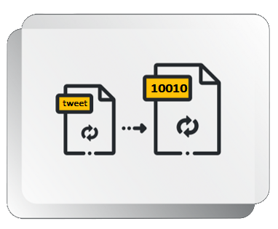
KEY CONCEPTS
Sentiment Analysis
Tokenization
The goal is to classify text like- tweet, news article, movie review or any text on the web into one of many categories. It is most commonly used to identify distressed customers from negative reviews.
It is the process by which a large quantity of text is divided into smaller parts called tokens. These tokens are very useful for finding patterns and are considered as a basic step for stemming and lemmatization.

Slide 17

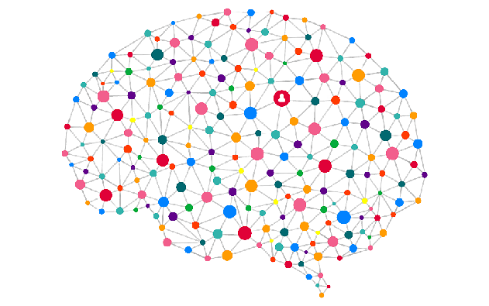
Natural Language Processing
Recurrent Neural
Network
NLP is a standard python library with built-in functions and utilities for the ease of use and implementation. It is one of the most used libraries for natural language processing and computational linguistics.
Here the output from the previous node is fed as input to the current step. In this cases when it is required to predict the next word of a sentence, the previous words are required and hence there is a need to remember the previous words.

Slide 18
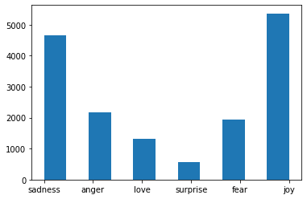
EXPERIMENTAL SETUP
First, we install all the required packages like matplotlib, nlp, snscrape, tensorflow.
We imported “emotion” dataset of English Tweets with six basic emotions:
anger, fear, joy, love, sadness, and surprise.
Fig: Original Imbalanced Dataset
Balancing this dataset was the real challenge in this project.

Slide 19
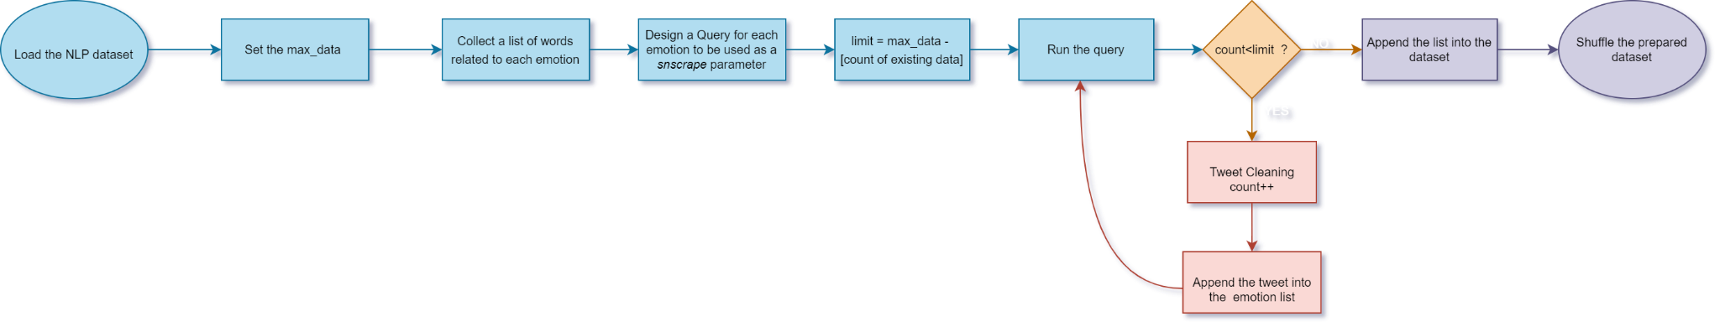
To make the emotion dataset balanced:
We tried to make the count of tweets for all the 6 emotions to 5500.
In order to increase the count of emotions classes, we scraped tweets using snscrape.
We searched for all the related words for the six emotions.
Using the collected words, we designed multiple queries to scrape the tweets using the snscrape library.
Then, we added the newly fetched tweets to the previous emotion classes.
Fig: Balancing the Imbalanced Dataset

Slide 20
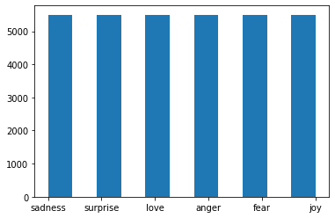
PROCEDURES ADOPTED
Importing packages and libraries
This step involves importing packages like NumPy, TensorFlow,
Matplotlib, NLP, Pandas, RegEx, snscrape and Emoji module.
Importing data
We imported “emotion” dataset of English Twitter messages with six basic emotions: anger, fear, joy, love, sadness, and surprise.
Fig: Balanced Emotion Dataset

Slide 21
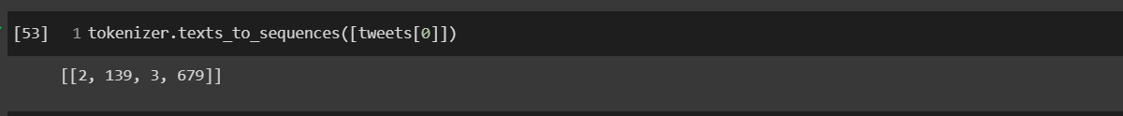
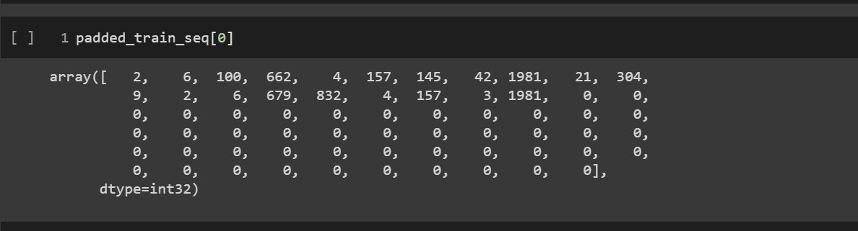
Tokenization of the tweets
Tokenization is the process by which a large quantity of text is divided into smaller parts called tokens. We can see the example of a tokenized tweet in the figure below.
Padding and Truncating the tokenized sequences
We’ll be padding & truncating the sequences which are generated from the Tokenizer as the model will need a fixed input shape and the tweets may not be all of the same shape.
Fig: Tweets Tokenization
Fig: Padded Sequences

Slide 22
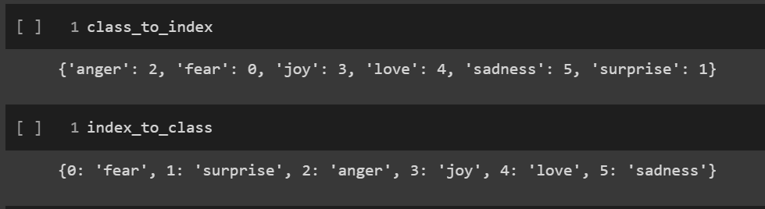
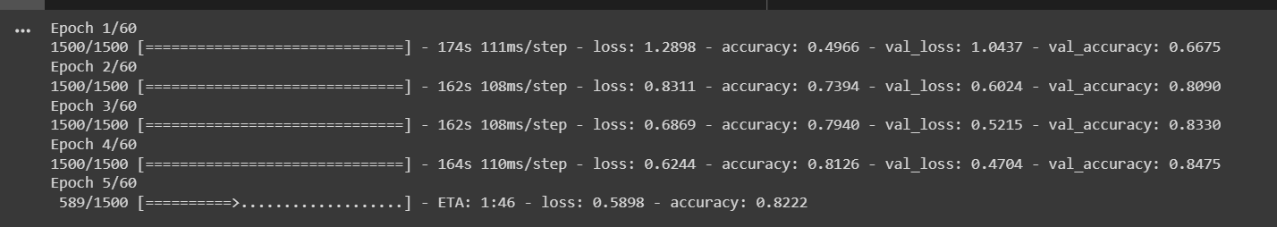
Preparing the Labels
Using the multi-class classification approach, we will create a set of all unique classes based on the labels present in the training dataset.
Creating and Training RNN Model
We will build our model using the Sequential class from Keras and a list of layers. And finally compile the model.
Fig: Labels Preparation
Fig: Training the Model

Slide 23
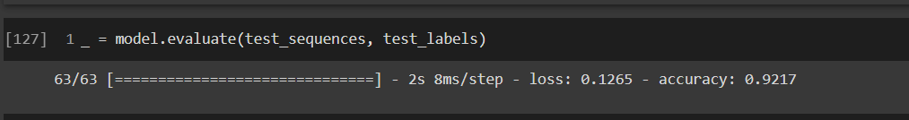
Model Evaluation
Evaluation is a process during development of the model to check whether the model is best fit for the given problem and corresponding data.
On visualizing the model training history using matplotlib functions, we conclude that the accuracy increases constantly and the general trend of loss is decreasing for both training & validation set.
Fig: Evaluating the Model

Slide 24
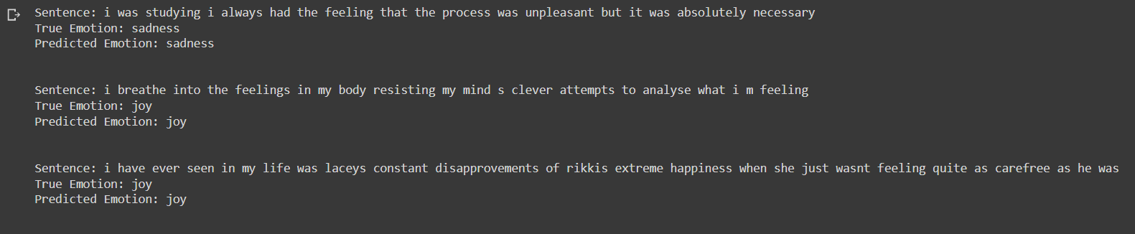
TESTING
Next, we tested the model on a different dataset and found that the results were mostly correct.
Below, we have provided a snapshot of the testing phase.
Fig: True Emotion vs Predicted Emotion

Slide 25
RESULTS
It focuses on analyzing the sentiments of the tweets by feeding the data to a machine learning model in order and to check its accuracy, so that we can use this model for future implementations according to the results.
The development phase comprises of steps like data collection, text pre-processing, training and testing the model.
This research topic has evolved during the last decade with models reaching the efficiency of almost 85%-95%.
By evaluating the model based on test sequences and test labels, we achieve a precision of 92.17% and a loss of 12.65%.
Even though the model has a high accuracy score, we still have room to improve our model.

Slide 26
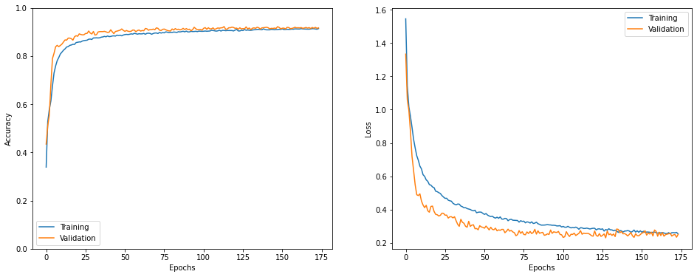
The Model train history graph shows that the training accuracy has increased steadily. And loss has also declined with each epoch for both training & validation datasets.
Fig: Accuracy & Loss Graph

Slide 27
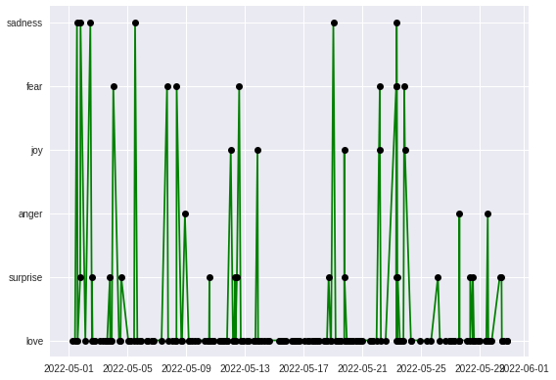
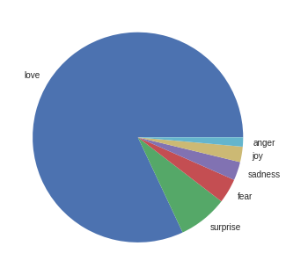
IMPLEMENTATION
We performed Sentiment Analysis on real-time tweets on “#bmw” by taking 1000 tweets ranging from 1st May 2022 to 1st June 2022,
We found that almost 80% of the twitter users had love sentiment associated with hashtag #bmw.
Fig: Time vs Sentiment Graph
Fig: Emotion Pie Chart

Slide 28

CONCLUSION
Sentiment analysis is used to identify people’s opinion, attitude and emotional states. Sometimes, words having adjectives and adverbs are used together. Then, it becomes difficult to identify sentiments and opinions.
In this project, we tried to show the basic way of classifying tweets into 6 different categories- namely joy, love, sadness, fear, surprise and anger. We could further improve our classifier by trying to extract more features from the tweets, trying different kinds of features or by using another classifier all together.

Slide 29
FUTURE SCOPE
Future areas of application that may be included in our research include, but are not limited to:
The use of parser can be embedded into the system to improve results.
We can improve our system to deal with multiple-meaning sentences.
We can also expand classification categories to achieve better outcomes.
We can also improve the system to understand multiple languages like Hindi, Spanish, and Arabic to provide sentiment analysis to more locals.

Slide 30

THANK YOU!
First and foremost, we would like to praise and thank God, the almighty, who has granted countless blessings, knowledge, and opportunity so that we could successfully complete this project.
We would like to express our sincere gratitude to Prof. Biswajit Saha, Computer Science and Engineering department, for being an excellent mentor during our whole course of project. His encouragement and valuable advice during the entire period has made it possible to complete our thesis.
We are extremely thankful to Dr. Prof. Chandan Koner, Head of CSE Department, for setting high standards for his students and encouraging them to achieve them as well. We convey our gratitude to the entire faculty for providing us the technical skills that will always remain as our asset and to all the staff for the gracious hospitality they offered us.
We would like to thank our parents for their unyielding love and support. Lastly, we are thankful to all those whose guidance and motivation enabled us in achieving the objectives of this project.

